Slide 1
Did King Lear have dementia? Shakespeare on aging & illness
Art Walaszek, MD
Professor of Psychiatry and Medicine
University of Wisconsin School of Medicine & Public Health
March 2024
Notes:
Getty images

Slide 2
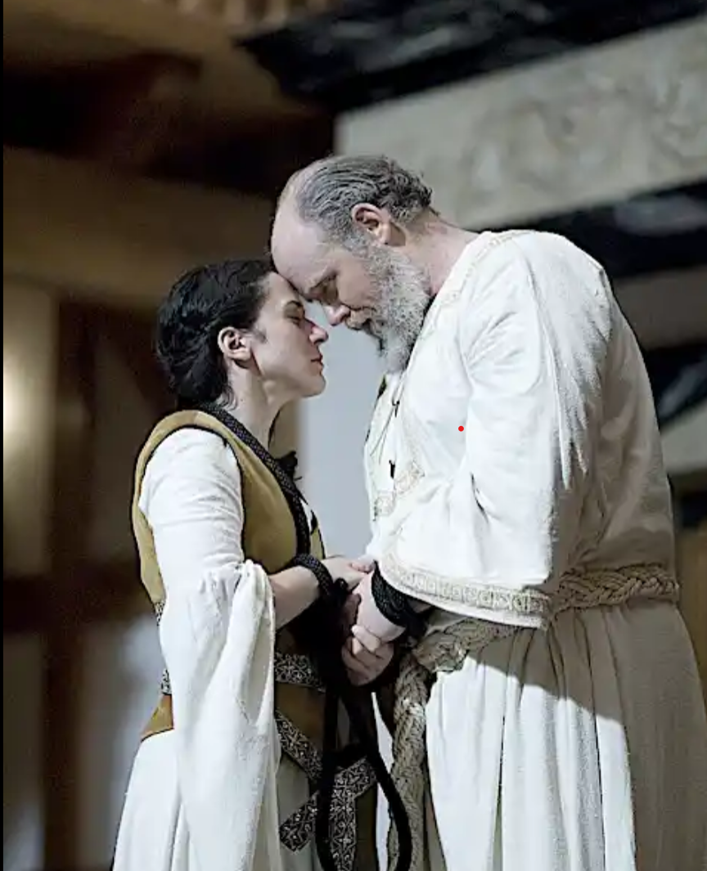
What can Shakespeare teach us about aging & illness?
Brief introduction to Shakespeare and his time
The story of King Lear
Feigned and actual madness in King Lear
Lear as a case of dementia with Lewy bodies
Studying the humanities as a way of understanding aging and mental illness
Cordelia and Lear, about to taken away to prison.
Notes:
King Lear (James Keegan) shares a tender moment with his youngest daughter, Cordelia (Alyssa Wilmoth), as they are taken away to prison. © Photo by Tommy Thompson, American Shakespeare Center.

Slide 3
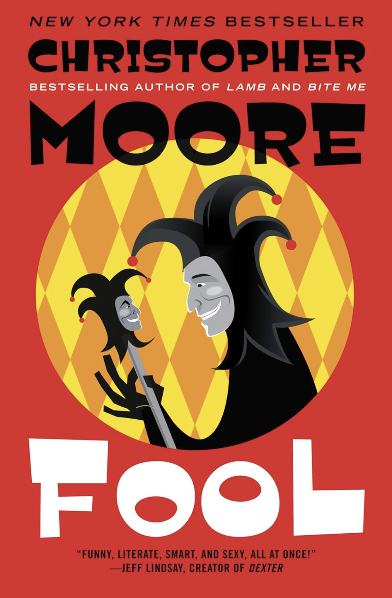
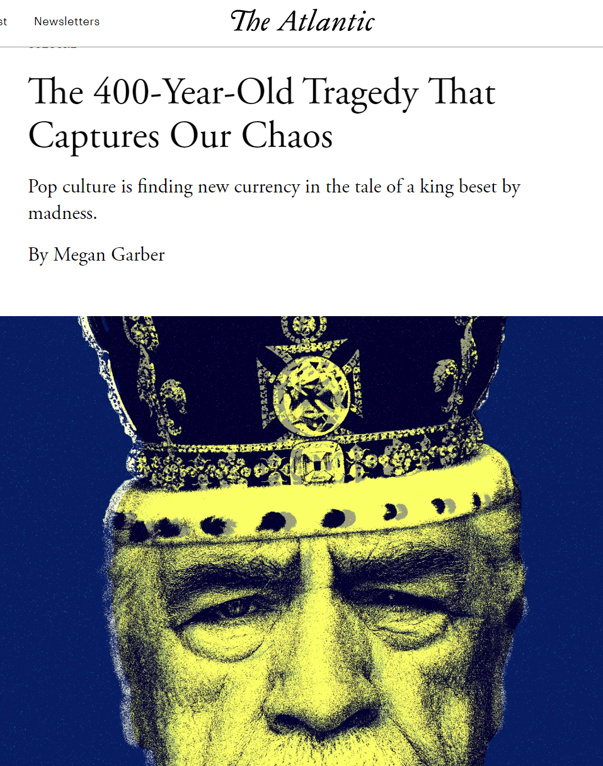
King Lear tells a remarkably modern story
Notes:
Jane Smiley’s A Thousand Acres
First published in 1991, winner of Pulitzer Prize and National Book Critics Circle Award.
“A successful Iowa farmer decides to divide his farm between his three daughters. When the youngest objects, she is cut out of his will. This sets off a chain of events that brings dark truths to light and explodes long-suppressed emotions. An ambitious reimagining of Shakespeare's King Lear cast upon a typical American community in the late twentieth century, A Thousand Acres takes on themes of truth, justice, love, and pride, and reveals the beautiful yet treacherous topography of humanity.”
Larry Cook and his children, Ginny, Rose and Caroline.
Fool
First published 2009, Fool is King Lear told from the perspective of the jester.
Succession
King Lear isn’t the only source for Succession, but it is a major one. Logan Roy (roi/king) leads a huge media conglomerate. As his health fades, his children vie to take over: Kendall, Roman, Shiv, and Connor.
https://www.theatlantic.com/culture/archive/2023/05/king-lear-shakespeare-succession-logan-roy/674205/
Illustration by Joanne Imperio / The Atlantic. Sources: Magnus Wennman / Alamy; Graphica Artis / Getty.
Eexecutive producer Adam McKay described as “as a King Lear for the media-industrial complex”

Slide 4
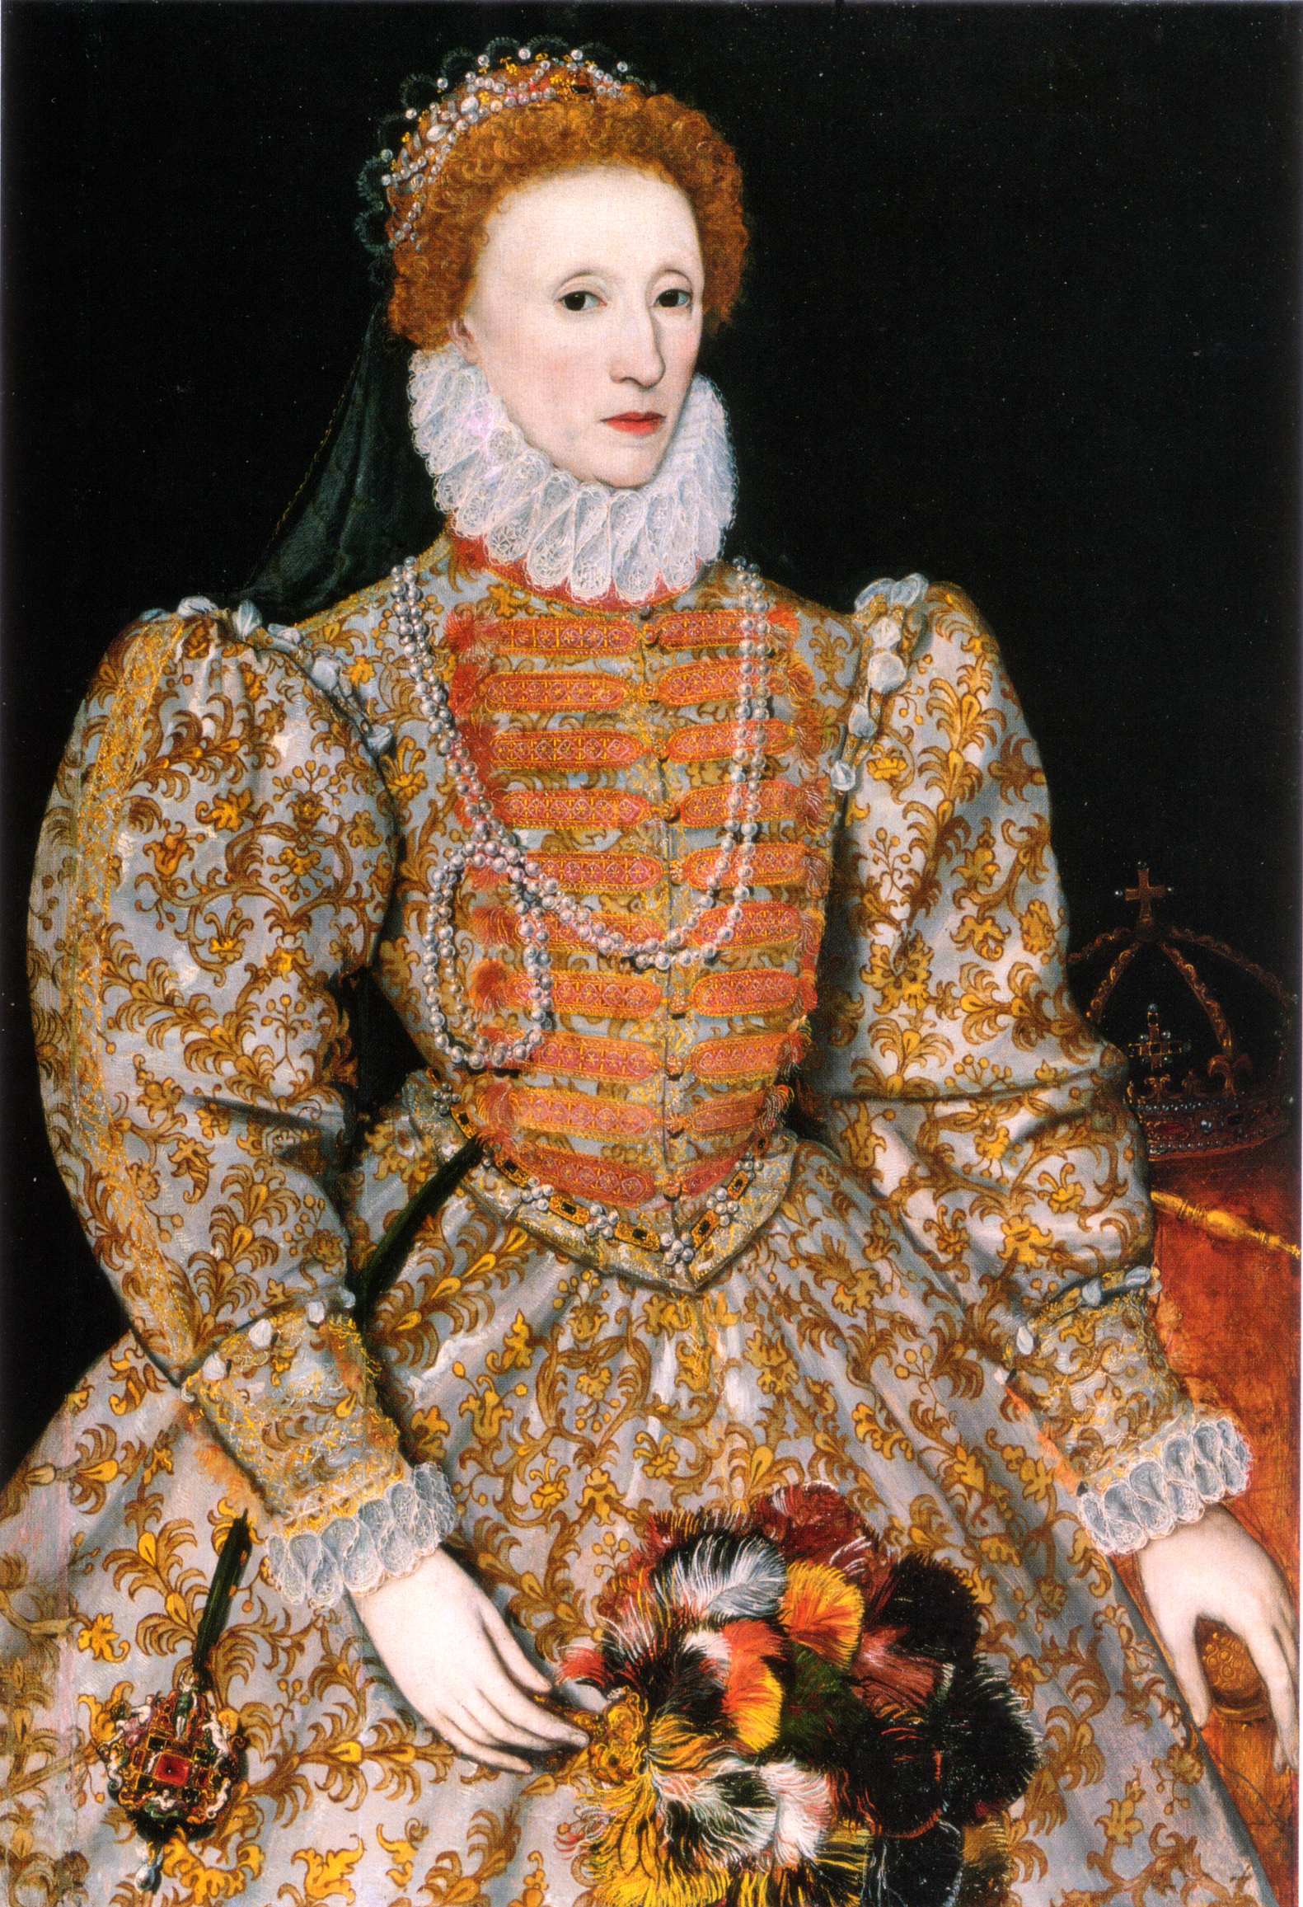
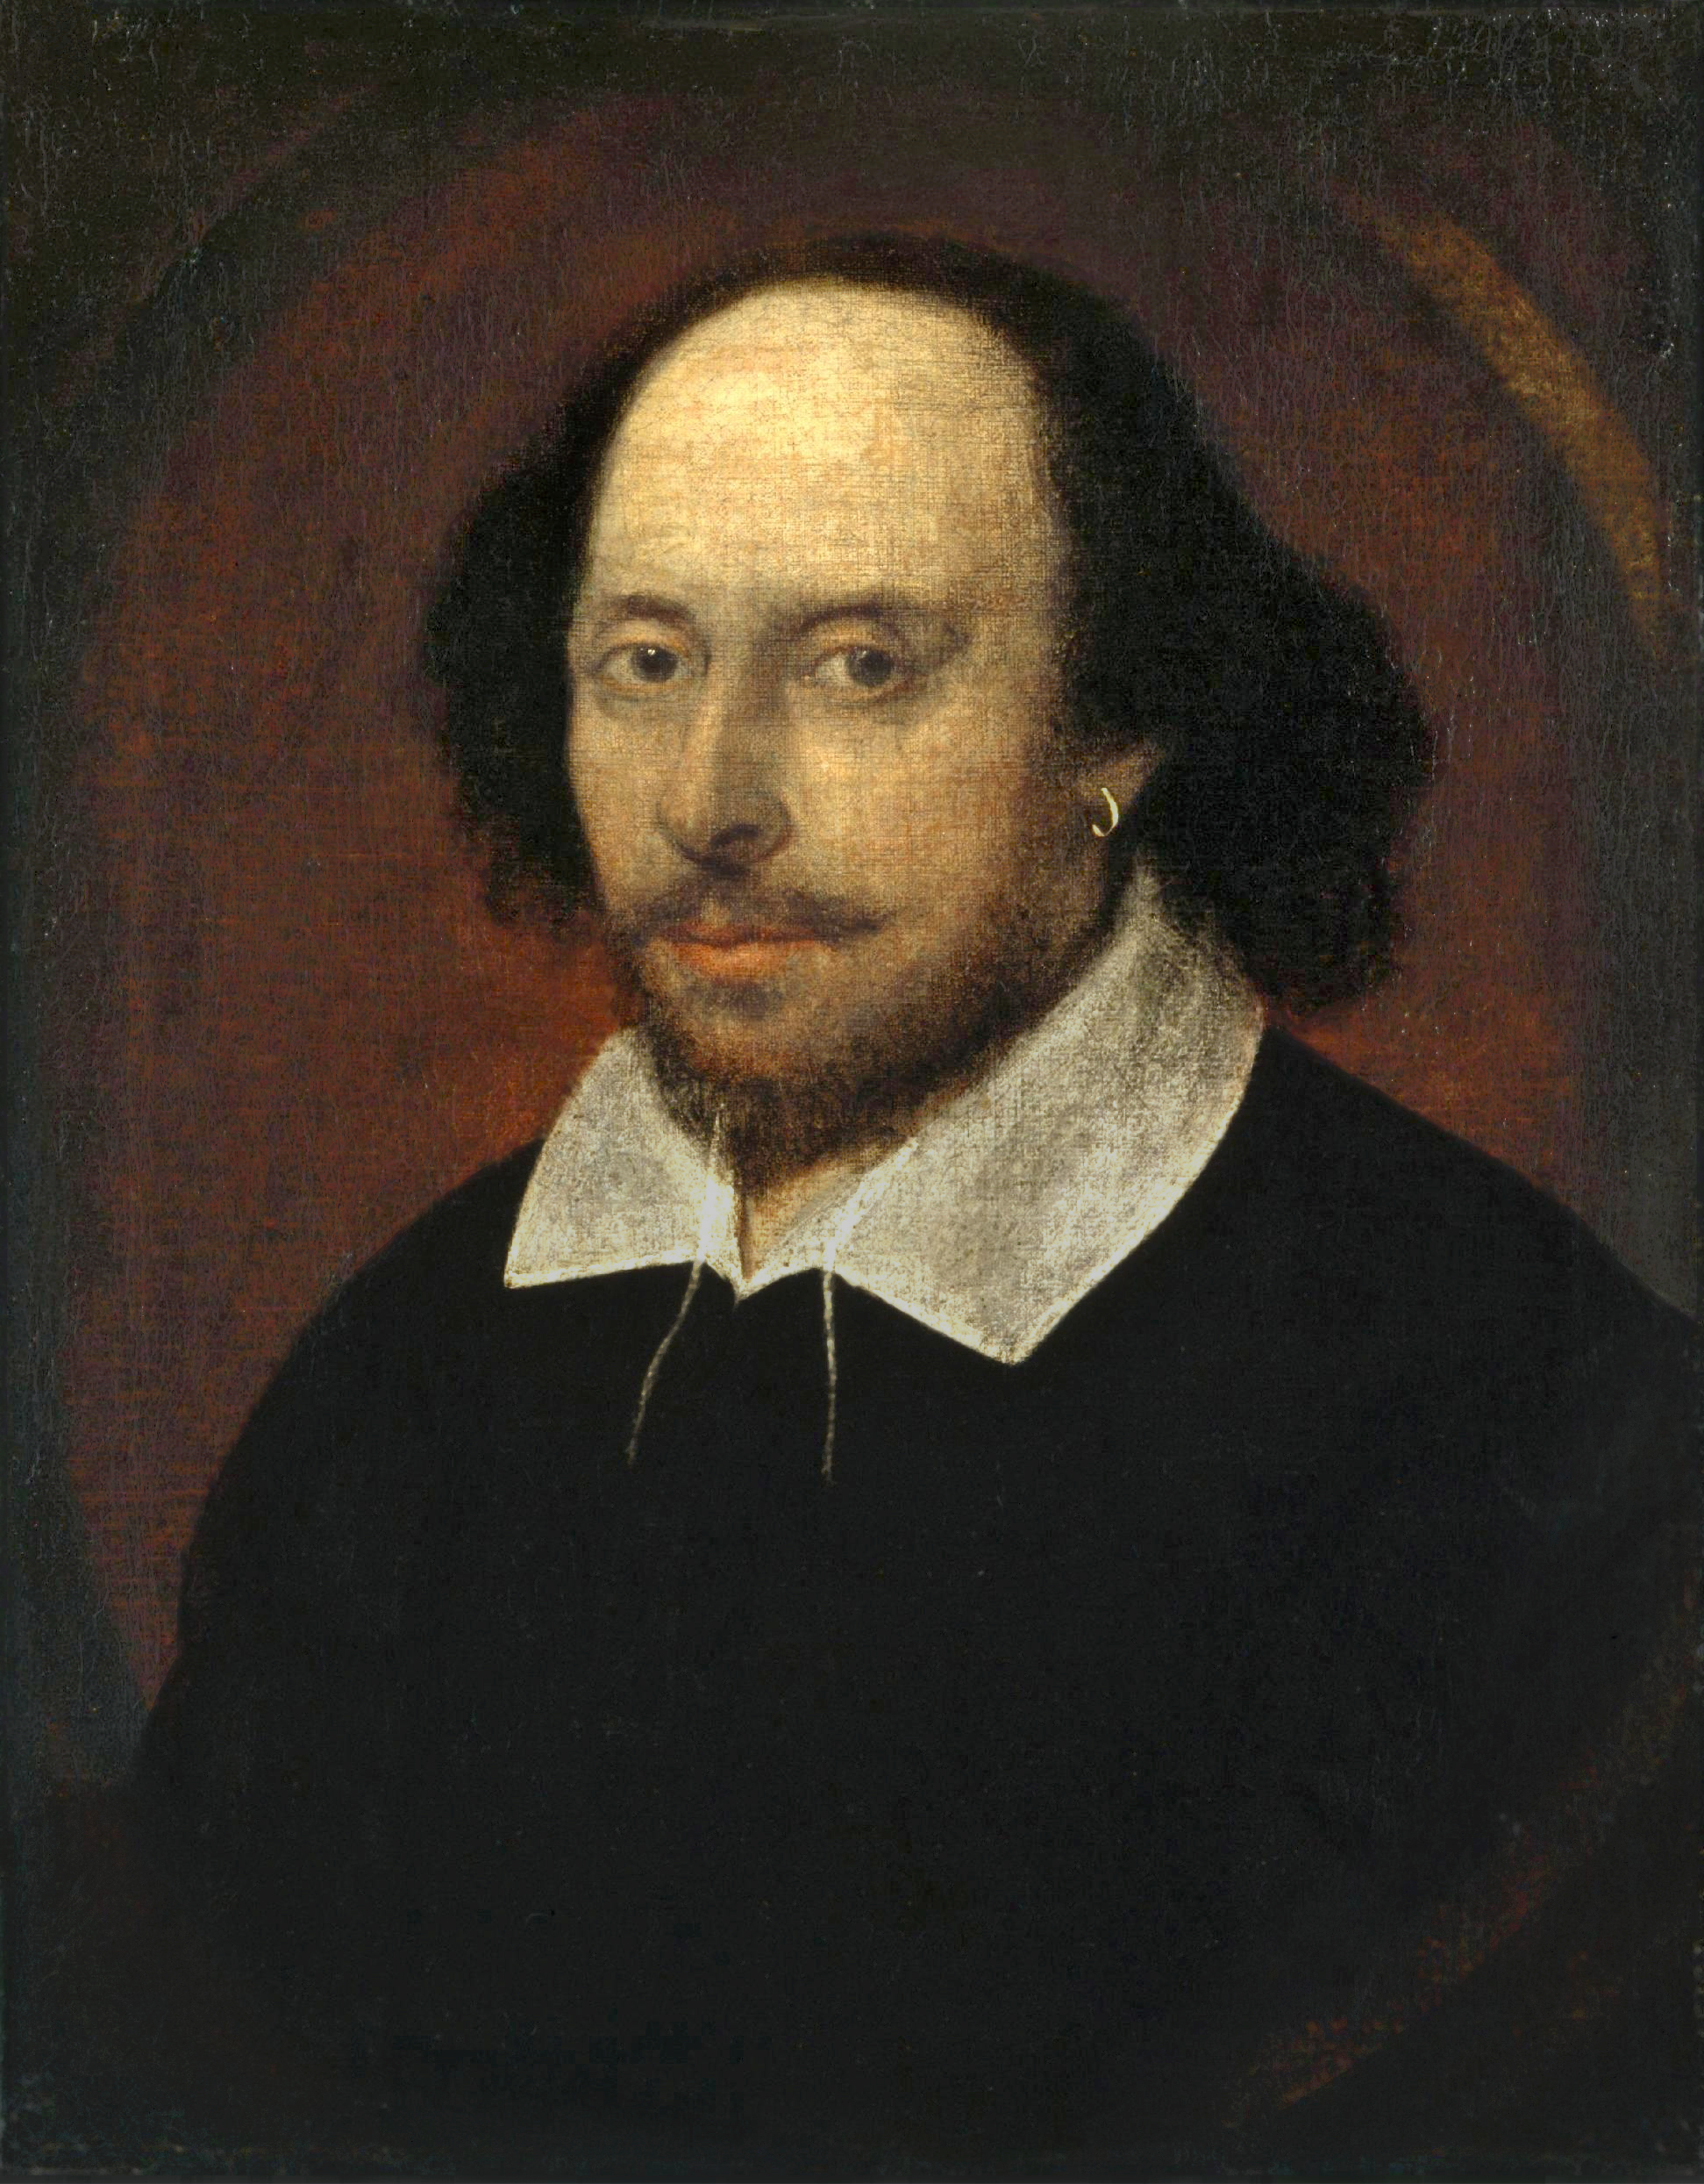
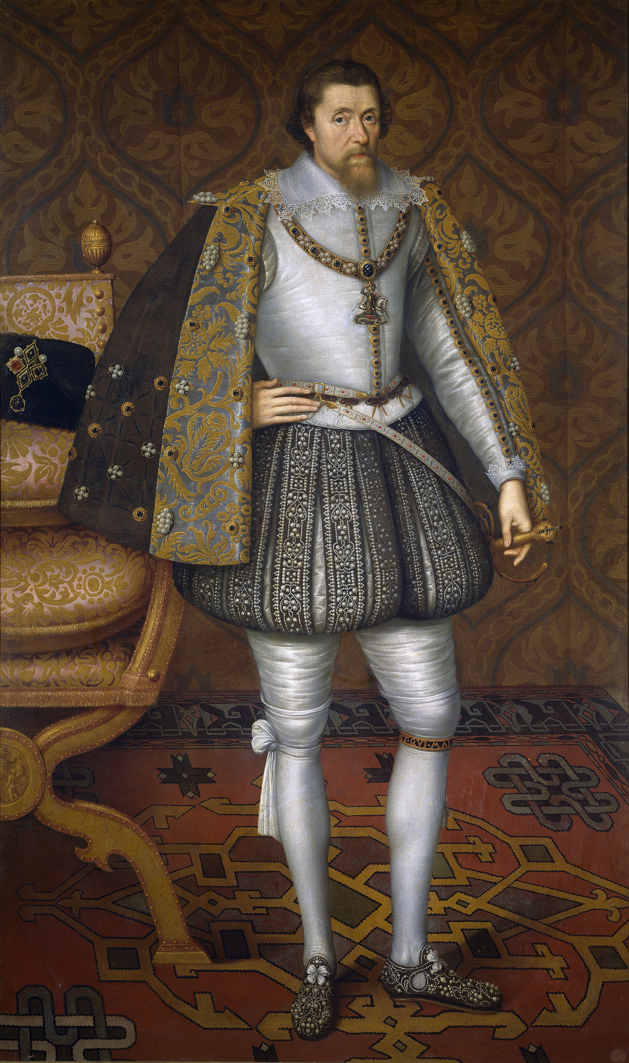
Shakespeare and his time
Queen Elizabeth I
1533-1603
reigned: 1559-1603
William Shakespeare
1564-1616
active: 1592-1613
King James I
1567-1625
reigned: 1603-1625
Notes:
The Chandos portrait. This portrait is attributed to John Taylor, and dated to about 1610. In 2006, the National Portrait Gallery published a report authored by Tarnya Cooper saying it is the only painting with any real claim to have been done from life. The Cobbe portrait had not been discovered at that time, but Cooper has since confirmed her opinion. The name arose as it was once in the possession of the Duke of Chandos
The "Darnley Portrait" of Elizabeth I of England (1575). It was named after a previous owner. Probably painted from life, this portrait is the source of the face pattern called "The Mask of Youth" which would be used for authorized portraits of Elizabeth for decades to come.
Attributed to John de Critz - Prado image (1605) Quick bio: https://www.rsc.org.uk/shakespeares-life-and-times

Slide 5
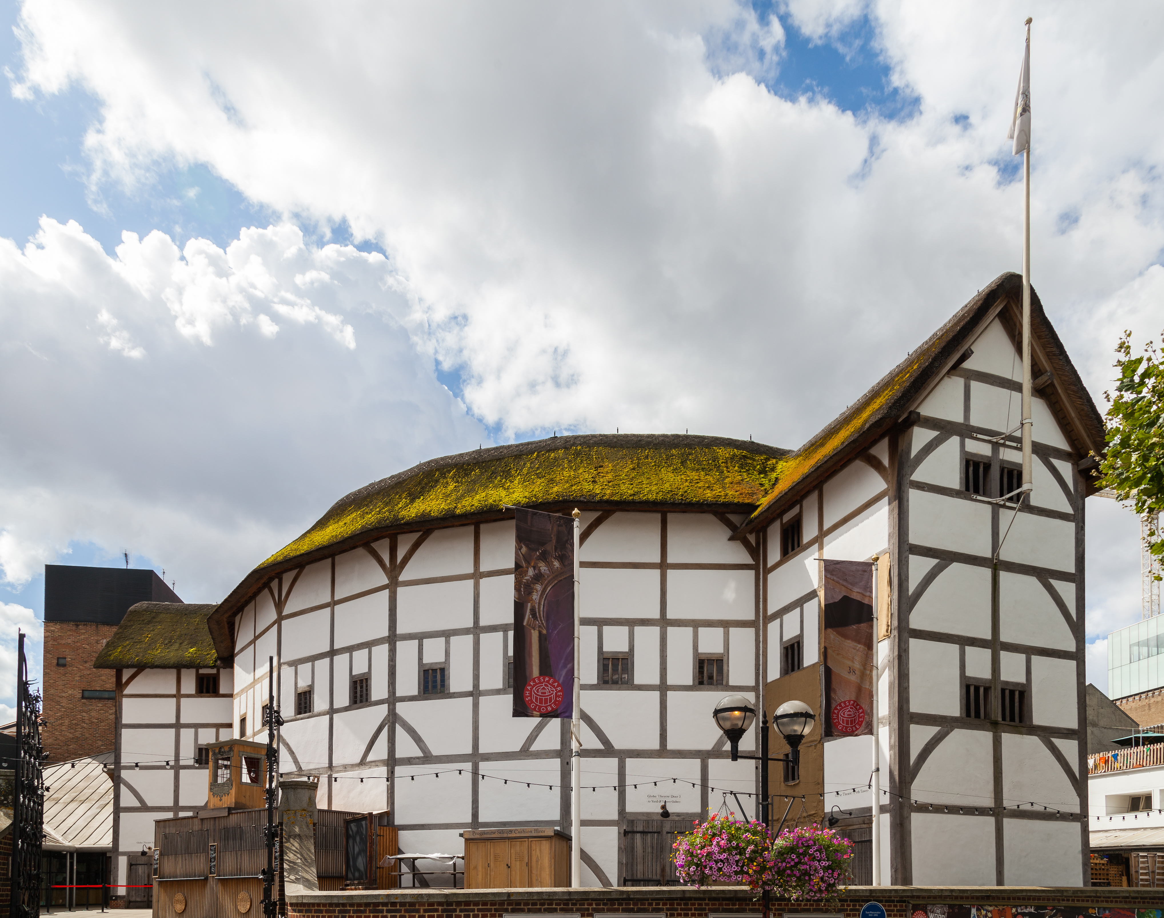
The Globe Playhouse
Conjectural reconstruction of the Globe Theatre
Modern-day Shakespeare’s Globe
Notes:
The Globe was built in 1599. It burned down in 1613, very soon after Shakespeare’s retirement. It was home of Shakespeare’s company, The Lord Chamberlain’s Men (later, The King’s Men). A second Globe Theatre was built on the same site by June 1614 and stayed open until the London theatre closures of 1642, right after the First English Civil War.
Conjectural reconstruction of the Globe theatre by C. Walter Hodges based on archaeological and documentary evidence, 1958
Modern-day Globe credit: Diego Delso, August 11, 2014

Slide 6
Timeline of major works
Hamlet
1600
Othello
1605-06
King Lear
1605-06
MacBeth
1606
The Tempest
1611
Notes:
Source: https://www.rsc.org.uk/shakespeares-plays/histories-timeline/timeline
First play is Taming of the Shrew, thought to have been written before 1592. The last plays were Henry VIII and The Two Noble Kinsmen, 1613 and 1613-14, respectively.

Slide 7
The story of King Lear
“It’s a perverse Cinderella story complete with an innocent young princess and two ugly sisters, but one in which our heroine, rather than being whisked off to the ball, is instead savagely mown down by that pumpkin coach, drawn by mice coachmen of the apocalypse.”

Slide 8
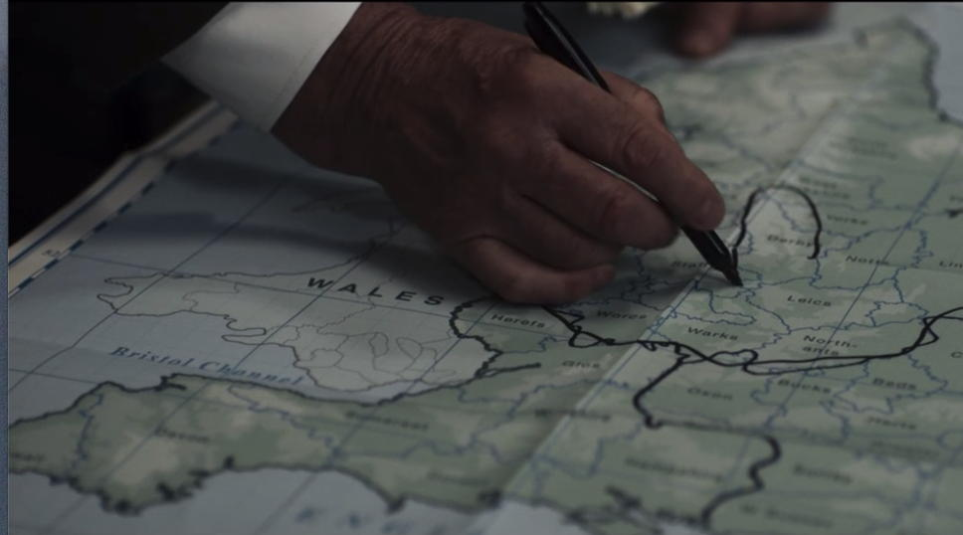
The love-test
King Lear
Goneril
(Albany)
Regan
(Cornwall)
Cordelia
(France)
Lear’s “love test” of Goneril, Regan & Cordelia results in
Lear banishing Cordelia (and Kent, too). Lear divides his
kingdom between Goneril & Regan and plans on splitting his time between their households.
Notes:
Both images are from the 2018 Prime Video adaptation of King Lear, starring Sir Anthony Hopkins, Emma Thompson (Goneril), Emily Watson (Regan), and Florence Pugh (Cordelia)

Slide 9
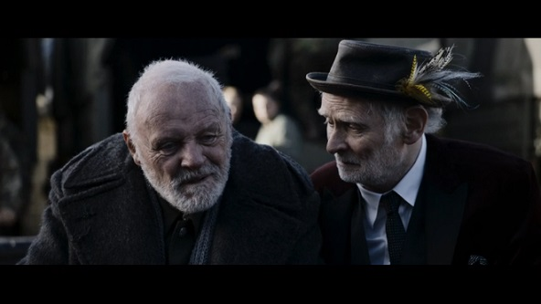
Lear gets no love from Goneril or Regan
100
Goneril
Goneril: What need you five and twenty? ten? or five?
Regan: What need one?
Regan
Notes:
Emily Watson (Regan) and Emma Thompson (Goneril) unite against Lear

Slide 10
Edmund plots against Edgar & Gloucester
Edmund tricks Gloucester into believing that Edgar is scheming to kill Gloucester and take his money.
Edmund warns Edgar that Gloucester is angry with him. Edgar goes into hiding.
Edmund advises Edgar to flee. Edmund cuts himself to make Gloucester think that Edgar wounded Edmund and then escaped. Regan & Cornwall are impressed with Edmund.
Edgar decides to disguise himself as a “Bedlam beggar” named Poor Tom.
Gloucester
Edgar
Edmund

Slide 11
Notes:
Video capture from Prime’s King Lear (2018), with Andrew Scott as Edgar becoming Poor Tom.

Slide 12
Lear in the wilderness
Lear: Blow, winds and crack your cheeks! Rage, blow!
You cataracts and hurricanoes, spout
Till you have drenched our steeples, drowned the cocks!
You sulphurous and thought-executing fires,
Vaunt-couriers of oak-cleaving thunderbolts,
Singe my white head! …
Notes:
Laurence Olivier as Lear and John Hurt as the Fool.
Lear’s speech is in Act 3, Scene 2.

Slide 13
Lear’s mock trial of Goneril & Regan
Lear is the prosecutor
Kent, the Fool, and Poor Tom are the jury
And a stool is the defendant, Goneril
Notes:
Video capture from Prime’s King Lear (2018), with Andrew Scott as Poor Tom, Jim Carter as Kent, and Karl Johnson the Fool

Slide 14
“Out, vile jelly"
Edmund tricks Cornwall, Regan & Goneril into believing that Gloucester is a traitor.
Cornwall gouges out Gloucester’s eyes: Gloucester realizes that Edmund was a liar and Edgar was true.
Edgar (disguised as Poor Tom) finds Gloucester and pretends to lead him to the Cliffs of Dover to attempt suicide.
Lear, now crowned with wildflowers, is reunited with Gloucester.
Notes:
Jack Wilkinson as Edgar, John Branwell as Gloucester Feb 2015
©NOBBY CLARK

Slide 15
Britain at war
Cordelia invades Britain with the armies of France.
Goneril & Regan each try to seduce Edmund. Edmund plots to kills Albany so that he can marry Goneril. Goneril poisons Regan, then stabs herself and dies.
Cordelia & Lear are captured and are to be executed.
Edgar returns and slays Edmund in a duel.
Notes:
Brooklyn Academy of Music production, 2014
Max Bennett as Edmund and Sebastian Armesto as Edgar

Slide 16
Lear’s end
Lear: Howl, howl, howl, howl! O, you are men of stones!
Had I your tongues and eyes, I’d use them so
That heaven’s vault should crack: she’s gone for ever.
I know when one is dead and when one lives;
She’s dead as earth. [he lays Cordelia down]
Lend me a looking glass.
If that her breath will mist or stain the stone,
Why then she lives.
Kent: Is this the promised end?
Edgar: Or image of that horror?
Albany: Fall, and cease.
Notes:
Sir Ian McKellan as Lear carrying Cordelia in the Royal Shakespeare Company’s 2007 production.

Slide 17
Edgar’s closing words
The weight of this sad time we must obey,
Speak what we feel, not what we ought to say.
The oldest hath borne most; we that are young
Shall never see so much, nor live so long.
Notes:
In most versions, Edgar speaks these words; in others, Albany does.

Slide 18
Perhaps include clips here
Opening scene / love-test
Lear bringing in Cordelia’s body

Slide 19
Shakespeare & medicine
epilepsy¹
“He fell down in the market-place, and foam’d at the mouth, and was speechless” (Julius Caesar)
“My lord [Iago] is fall’n into an epilepsy” (Othello)
“This fit is momentary; upon a thought he will be well again” (Macbeth)
sleep apnea¹
“Falstaff! - fast asleep…and snorting like a horse. Hark, how hard he fetches breath” (Henry IV)
parkinsonism/tremor²
“this arm of mine, now prisoner to the palsy” (Richard II)
“Why dost thou quiver, man?” “The palsy, and not fear, provokes me.” (Henry VI 2)
syphilis³
“raw eyes” = syphilitic episcleritis, iritis or uveitis
“incurable bone-ache” = syphilitic periostitis
“limekilns in the palm” = papulosquamous palmar rash (Troilus & Cressida)
¹Matthews B, Frontiers Neurol Neurosci 2010;27:216-226.
²Paciaroni M & Bogousslavsky J, Progress in Brain Research 2013;206:3-18.
³Ross JR, Clinical Infectious Diseases 2005;40:399-404.
Notes:
Lady Macbeth may be referring to Macbeth having an absence seizure
Ross (2005):
Syphilis was widespread in England by the 16th century, especially in the boisterous merchant city of London. Surviving records indicate that, in 1548, a total of 24% of the patients of St. Bartholomew’s Hospital (now known as Barts) in London were syphilitic; in 1579, the physician William Clowes claimed that up to 75% of the patients at Barts had the French pox [7].
Syphilis was more severe in the 15th and 16th centuries than it is today [9–11]. Gruesome clinical descriptions of primary, secondary, and gummatous syphilis quickly appeared.
By Shakespeare’s time, syphilis was less explosive in onset, perhaps because of attenuated virulence or improved population immunity, nutrition, and hygiene, with decreased bacterial superinfection. Use of the term “syphilis” was not common until the 19th century [10]. Shakespeare refers to syphilis as the pox, the malady of France, the infinite malady, the incurable bone-ache, the hoar leprosy, and most oddly as “the good-year” (a corruption of the French term “goujere,” from “gouge,” meaning prostitute)
Thersites’ insulting of Patroclus in Troilus and Cressida:
Why, his masculine whore. Now the rotten diseases of the south, the guts-griping, ruptures, catarrhs, loads o’ gravel in the back, lethargies, cold palsies, raw eyes, dirt-rotten livers, whissinglungs, bladders full of impostume [abscesses], sciaticas, limekilns i’ th’ palm [palmar rash], incurable bone-ache [periostitis], and the rivelled fee-simple of the tetter [essentially, the perpetual legacy of the illness], take and take again such preposterous discoveries.
This appears to be based on Greene’s Planetomachia (1585)

Slide 20
Bedlam
St. Mary of Bethlehem was founded in 1247, originally intended for the poor and unhoused suffering from any ailment
the mentally ill (“distracted persons”) started being admitted in 1377
“Bedlam beggars” either had been at Bedlam or feigned mental illness
17th-century broadside, featuring a malingering beggar
Mason D, Am J Psychiatry 2014; 171(12):1257-58.
Notes:
Illustration of a 17th-century broadside, featuring a malingering beggar, set “to the tune of Tom of Bedlam” (from Euing Ballad number 55; published by permission of the University of Glasgow Library, Special Collections).
Catholic encyclopedia:
A London hospital originally intended for the poor suffering from any ailment and for such as might have no other lodging, hence its name, Bethlehem, in Hebrew, the "house of bread." During the fourteenth century it began to be used partly as an asylum for the insane, for there is a report of a Royal Commission, in 1405, as to the state of lunatics confined there. The word Bethlehem became shortened to Bedlam in popular speech, and the confinement of lunatics there gave rise to the use of this word to mean a house of confusion. Bedlam was founded in 1247 as a priory in Bishopsgate Street, for the order of St. Mary of Bethlehem, by Simon Fitz Mary, an Alderman and Sheriff of London. This site is now occupied by the Liverpool Street railway station. In the next century it is mentioned as a hospital in a license granted (1330) to collect alms in England, Ireland, and Wales. In 1375 Bedlam became a royal hospital, taken by the crown on the pretext that it was an alien priory. It seems afterwards to have reverted to the city. At the beginning of the sixteenth century the word Bedlam was used by Tyndale to mean a madman, so that it would seem as though the hospital were now used as a lunatic asylum exclusively. In January, 1547, King Henry VIII formally granted St. Bartholomew's hospital and Bedlam, or Bethlehem, to the city of London, on condition that the city spend a certain amount on new buildings in connection with St. Bartholomew’s … The attitude of successive generations of Englishmen towards the insane can be traced interestingly at Bedlam. Originally, it was founded and kept by religious. Every effort seems to have been made to bring patients to such a state of mental health as would enable them to leave the asylum. An old English word, "a Bedlam" signifies one discharged and licensed to beg. Such persons wore a tin plate on their arm as a badge and were known as Bedlamers, Bedlamites, or Bedlam Beggars.
REF: Walsh, J.J. (1907). Bedlam. In The Catholic Encyclopedia. New York: Robert Appleton Company. http://www.newadvent.org/cathen/02387b.htm

Slide 21
The feigned madness of Poor Tom
My face I’ll grime with filth,
Blanket my loins, elf* all my hair in knots
And with presented nakedness outface
The winds and persecutions of the sky.
The country gives me proof and precedent
Of Bedlam beggars, who, with roaring voices,
Strike in their numbed and mortified bare arms
Pins, wooden pricks, nails, sprigs of rosemary … [and]
Sometime with lunatic bans*, sometimes with prayers,
Enforce their charity.
Who gives anything to Poor Tom? Whom the found fiend hath led through fire and through flame … that hath laid knives under his pillow and halters in his pew; set ratsbane by his porridge** … bless thee from whirlwinds, star-blasting and taking.**
Lear: What hast thou been?
Edgar: … [I] served the lust of my mistress’ heart and did the act of darkness with her, swore as many oaths as I spake words … Wine love I deeply, dice dearly …
** The Devil encourages suicide via knives, halters (ropes for hanging) or ratsbane
(poison). Tom invokes meteorological (whirlwinds), celestial (star-blasting), and
infectious (taken [by disease]) causes of illness.
* elf = tangle, bans = curses
Notes:
On the left is Edgar’s monologue in Act 2 when he decides to disguise himself as Poor Tom of Bedlam. On the right is the scene in Act 3 where Lear, the Fool and Kent come upon Tom hiding in a hovel.
Tom also notes that his diet includes “the swimming frong, the toad … cowdungs for salads; swallows the old rat and the ditch-dog; drinks the green mantle of the standing pool.
How is he treated? Well, he is “whipped from tithing to tithing and stocked, punished and imprisoned.” A statute of 1598 ordered that any vagabond apprehended in a Parish shall ”be openly whipped until his or her body be bloody and shall be forthwith sent from Parish to Parish” until returned ”to the Parish where he was borne.”

Slide 22
Poor Tom says …
O do, de, do, de, do, de
There I could have him now, and there, and there again, and there.*
Pillicock sat on Pillicock hill,
Alow, alow, loo, loo!
Flibbertigibbet… Smulkin…Modo…Mahu...Frateretto…Purr**
His word was still “Fie, foh and fum, I smell the blood of a British man.”
* Tom is hallucinating
** the names of various devils
Notes:
“O do, de, do, de, do, de” – Act 3, Scene 4
“Pillicock … “ – Act 3, Scene 4 – pillicock is slang for penis
The names of the devils likely come from Samuel Harsnett’s A Declarations of Egregious Popish Impostures (1603), which is a critique of Catholic priests who performed exorcisms
Photo: Jacob Fishel as Edgar, disguised as Poor Tom, in the 2014 production of King Lear for Theatre for a New Audience (NY). © Carol Rosegg

Slide 23
What do we know about Lear’s history?
80+ year old man
widowed? more than once?
relationships:
daughters: Goneril, Regan, Cordelia
sons-in-law: Albany, Cornwall
friends: Kent, Gloucester
developmental history: unknown
medical history: unknown
occupational history: King of the Britons
Notes:
According to Geoffrey of Monmouth’s 12th-century History of the British Kings, Leir’s father was King Bladud (who died when trying to fly with artificial wings). Leir ruled for 60 years, the longest of the ancient kings. He is part of the dynasty of Brutus of Troy (a descendant of Aeneas). Leir was the founder of Leicester.
Another source for Shakespeare’s King Lear is Holinshed’s Chronicles of England, Scotland, and Ireland. In the Chronicles, Leir gives half his kingdom (after the love test) to Gonerilla and Regan, with the rest to be divided after his death. Albany and Cornwall seize power and Leir flees to Gallia, where Cordeilla is. Cordeilla, Leir and the King of the Franks invade Britain, kill the Dukes, and Leir is restored to the throne. Cordeilla rules after his death until she is deposed by her nephews. According to the Chronicles, Leir was a “Prince of right noble demeanor, governing his land and subjects in great wealth.”

Slide 24
Lear’s personality*
Goneril: You see how full of changes his age is. The observation we have made of it hath not been little. He always loved our sister most, and with what poor judgement he hath now cast her off appears too grossly.
Regan: ’Tis the infirmity of his age, yet he hath ever but slenderly known himself.
Goneril: The best and soundest of his time hath been but rash; then must we look from his age to receive not alone the imperfections of long-engrafted condition, but therewithal the unruly waywardness that infirm and choleric years bring with them.
Regan: Such unconstant starts** are we like to have from him as this of Kent’s banishment.
* if we are to believe Goneril and Regan. ** sudden outbursts
Notes:
Act 1, Scene 1

Slide 25
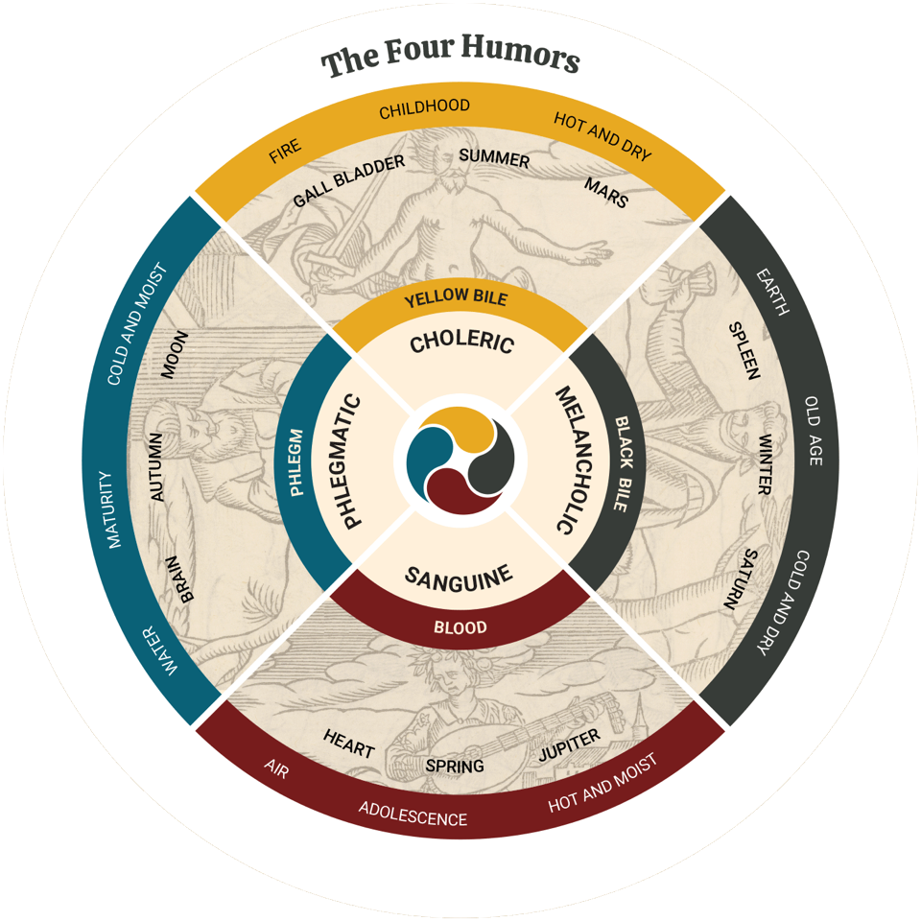
Humoral model of personality
adapted by National Library of Medicine from Thomas Walkington’s Optick Glasse of Humors (1607)
Notes:
Four humors chart adapted from Optick Glasse of Humors, Thomas Walkington (1575-1621), first published in 1607
https://www.nlm.nih.gov/exhibition/shakespeare-and-the-four-humors/index.html#section2

Slide 26
Shakespeare’s seven ages
Jaques: All the world’s a stage,
And all the men and women merely players.
They have their exits and their entrances,
And one man in his time plays many parts,
His acts being seven ages …
And then the justice,
In fair round belly with good capon lin’d,
With eyes severe and beard of formal cut,
Full of wise saws and modern instances;
And so he plays his part.
The sixth age shifts
Into the lean and slipper’d pantaloon,
With spectacles on nose and pouch on side;
His youthful hose, well sav’d, a world too wide
For his shrunk shank; and his big manly voice,
Turning again toward childish treble, pipes
And whistles in his sound.
Last scene of all,
That ends this strange eventful history,
Is second childishness and mere oblivion;
Sans teeth, sans eyes, sans taste, sans everything.
As You Like It, 2.7.139-166.
Notes:
The All the World’s a Stage speech: https://www.poetryfoundation.org/poems/56966/speech-all-the-worlds-a-stage
All the world’s a stage, And all the men and women merely players; They have their exits and their entrances; And one man in his time plays many parts, His acts being seven ages. At first the infant, Mewling and puking in the nurse’s arms; And then the whining school-boy, with his satchel And shining morning face, creeping like snail Unwillingly to school. And then the lover, Sighing like furnace, with a woeful ballad Made to his mistress’ eyebrow. Then a soldier, Full of strange oaths, and bearded like the pard, Jealous in honour, sudden and quick in quarrel, Seeking the bubble reputation Even in the cannon’s mouth. And then the justice, In fair round belly with good capon lin’d, With eyes severe and beard of formal cut, Full of wise saws and modern instances; And so he plays his part. The sixth age shifts Into the lean and slipper’d pantaloon, With spectacles on nose and pouch on side; His youthful hose, well sav’d, a world too wide For his shrunk shank; and his big manly voice, Turning again toward childish treble, pipes And whistles in his sound. Last scene of all, That ends this strange eventful history, Is second childishness and mere oblivion; Sans teeth, sans eyes, sans taste, sans everything.

Slide 27
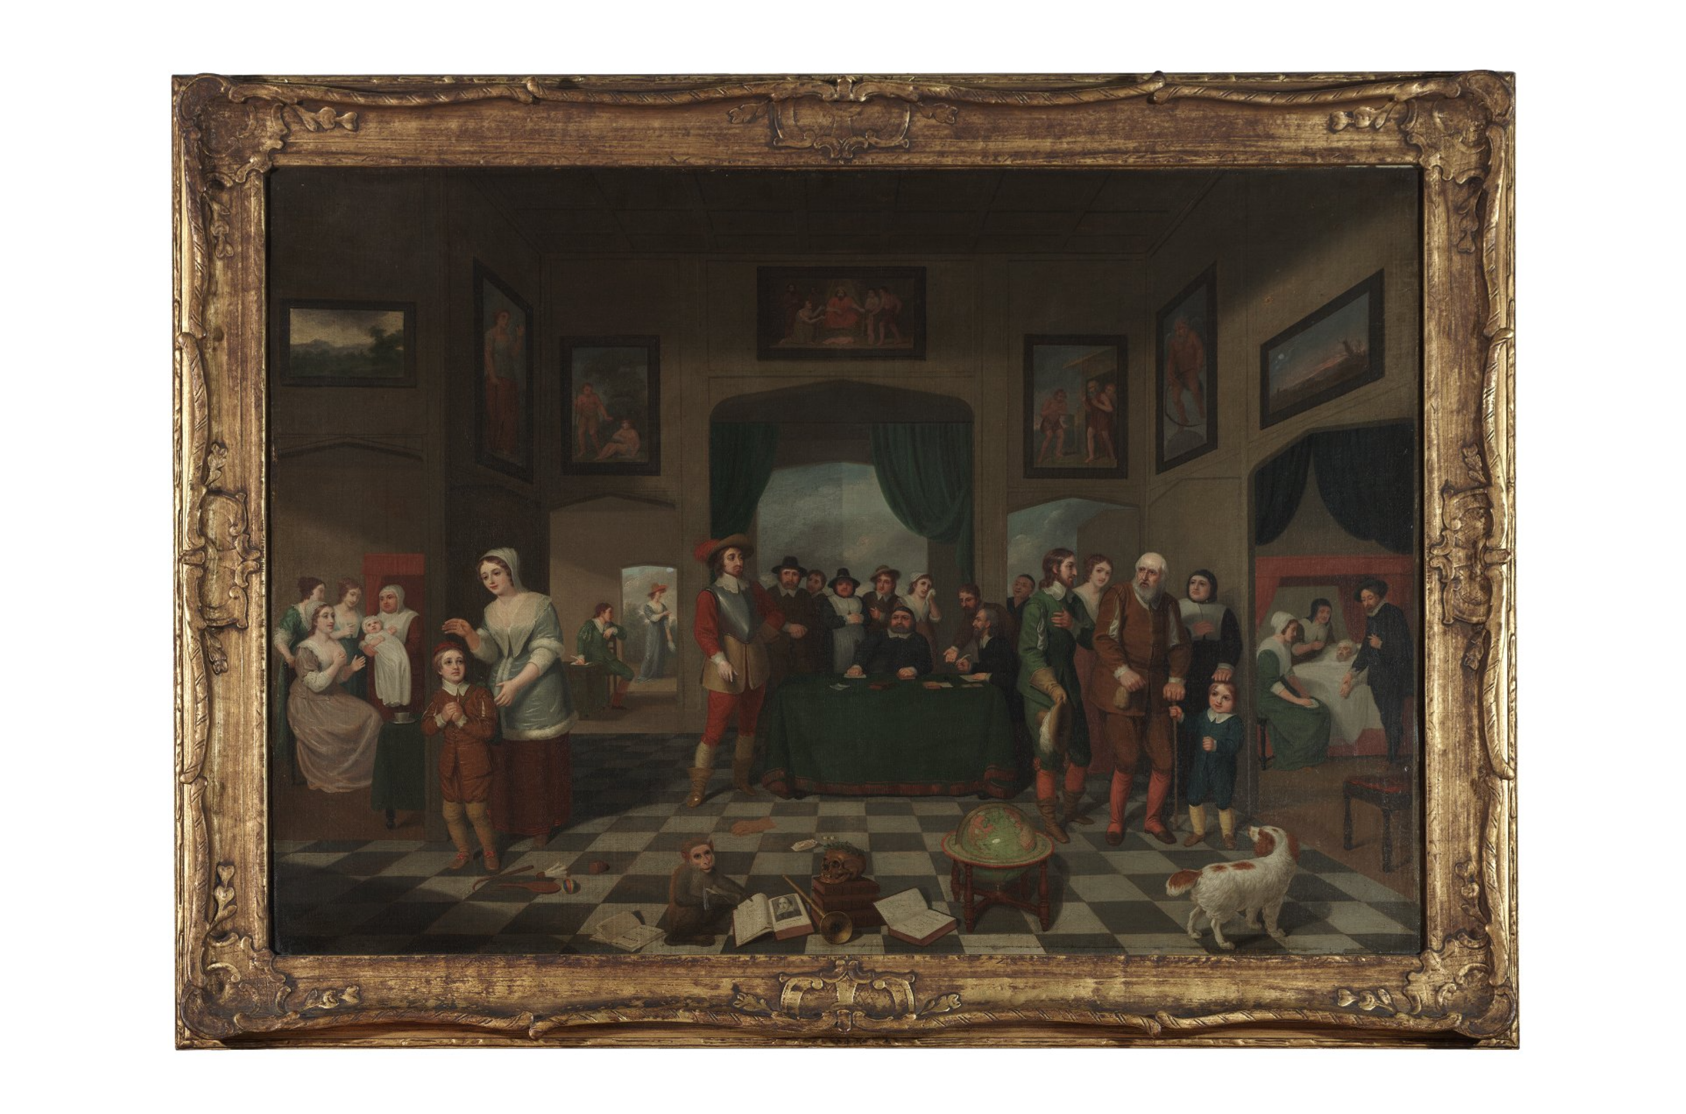
The seven ages of man (1823),
George James De Wilde,
Folger Shakespeare Library.
Notes:
The seven ages of man [graphic] / attributed to George James De Wilde
https://www.folger.edu/blogs/shakespeare-and-beyond/up-close-seven-ages-of-man-painting-as-you-like-it

Slide 28
Timeline of Lear’s madness (1/3)
Lear banishes Cordelia
Lear meets the Fool
Lear curses
Goneril & Regan
Lear & the Fool in the storm
~ 1 month
several days
Kent: Be Kent unmannerly when Lear is mad. What wouldst thou do, old man? … To plainness honour’s bound when majesty stoops to folly.
Fool: Thou shouldst not have been old till thou hadst been wise.
Lear: O let me not be mad, not mad, sweet heaven!
Lear: O, how this mother swells up toward my heart! Hysterica passio, down, thou climbing sorrow …
You see me here, you gods, a poor old man, as full of grief as age, wretched in both …
I will have such revenges on you both that all the world shall – I will do such things – what they are yet I know not, but they shall be the terrors of the earth!
Lear: Blow, winds and crack your cheeks … Here I stand your slave, a poor, infirm, weak and despised old man … My wits begin to turn.
Notes:
Lear banishes Cordelia: 1.1
Lear meets the Fool: 1.4 and 1.5 (quote is from 1.5)
Lear curses Goneril & Regan: 2.2 (suffocation of the mother), 2.4
Lear & the Fool in the storm: 3.2
Regarding the mother / suffocation of the mother / Hysteria passio: cf Jorden, A Brief Discourse of a Disease Called the Mother (1603). Shakespeare found the term in Harsnett (ibid.): “It riseth … of a wind in the bottome of the belly, and proceeding with a great swelling, causeth a very painfull collick in the stomach, and an extraordinary giddiness in the head.”

Slide 29
Timeline of Lear’s madness (2/3)
Kent seeks shelter for Lear
Gloucester tries to help Lear
The mock trial
Albany accuses Goneril of driving Lear mad
a day or two
Lear: This tempest in my mind doth from my senses take all feeling else, save what beats there, filial ingratitude … O, that way madness lies, let me shun that; no more of that.
Kent: His [Lear’s] wits being t’unsettle.
Gloucester: Thou sayest the King grows mad; I’ll tell thee, friend, I am almost mad myself … True to tell thee, the grief had crazed my wits.
Lear holds a mock trial of Goneril & Regan, appointing Kent, the Fool & Poor Tom as jurors. Lear hallucinates.
Kent: Trouble him [Lear] not; his wits are gone.
Albany [to Goneril]: A father, and a gracious aged man whose reverence even the head-lugged bear would lick, most barbarous, most degenerate, have you madded.
Notes:
Kent seeks shelter for Lear: 3.4
Gloucester tries to help Lear: 3.4
The mock trial: 3.6

Slide 30
Timeline of Lear’s madness (3/3)
Lear enters with a
crown of wildflowers
Lear & Cordelia
reunited
Lear hands out money to imaginary soldiers. He hallucinates a falcon and the sound of an arrow flying.
Edgar: Sweet marjoram.*
Lear does not recognize Gloucester or that he has been blinded.
Gloucester: The King is mad.
Lear wakes up thinking he has died. He has been dressed in royal clothes. He does not recognize Cordelia.
Lear: I am a very foolish and fond [silly] old man … I fear I am not in my perfect mind.
Lear: Methinks I should know you [Cordelia] and this man [Kent], yet I am doubtful; for I am mainly [entirely] ignorant what place this is all the skill [knowledge] I have remembers not these garments; nor I know not where I did lodge last night.
* marjoram was thought to be a remedy for “diseases of the brain and head”
Notes:
Lear with a crown of wildflowers: 4.6
Lear & Cordelia reunited: 4.7

Slide 31
Lear’s final words to Cordelia
No, no, no, no. Come, let’s away to prison;
We two alone will sing like birds i’ the cage.
When thou dost ask me blessing I’ll kneel down
And ask of thee forgiveness. So we’ll live
And pray, and sing, and tell old tales, and laugh
At gilded butterflies [courtiers], and hear poor rogues
Talk of court news …
Upon such sacrifices, my Cordelia,
The gods themselves throw incense. Have I caught thee?
[Lear embraces Cordelia]

Slide 32
Geriatric psychiatry formulation of Lear
Mr. L. is an 80-year old government employee with a several week history of cognitive decline and functional impairment in the context of retirement and severe familial stressors. His course is notable for the late-life onset of visual hallucinations, delusions, irritability, impulsivity, panic, and affective lability. The history appears to be most consistent with either major neurocognitive disorder or delirium. Work-up is necessary to evaluate for causes of delirium.
Vivid visual hallucinations and fluctuating mental status are suggestive of dementia with Lewy bodies. Given his age, Alzheimer’s disease is also a possibility. Changes in executive function and mood lability could be consistent with frontotemporal dementia, though onset in the 80s speaks against this. Neuroimaging is indicated to determine the extent of cerebrovascular disease.
The onset of a cognitive disorder also appears to have exacerbated Mr. L.’s pre-existing narcissistic personality traits and contributed to estrangement from his youngest daughter and closest friend. He appears to be having difficulty coping with a role transition and loss of power and structure.

Slide 33
Playing Lear as a person with dementia
Simon Russell Beale: “I bet Shakespeare, being the acute observer of human nature that he is, would have studied old men.”
His research into dementia informed his performance of Lear experiencing hallucinations, anxiety, irritability & tremor.
Furness H, The Telegraph 2/7/14
Notes:
Simon Russell Beale played Lear in the Sam Mendes-directed production at the National Theatre in London in 2014

Slide 34
Other views of Lear’s condition
Diagnoses
Interpretations
organic brain syndrome¹
delirium¹
acute hypochondriacal melancholy developing into mania⁸
acute schizophrenic-like episode²
personality disorder³
Lear’s “pride” & “impetuousness” as defenses against his inadequacies as a father²
Cordelia’s silence (“nothing”) represents death, hence Lear initially banishing her and then ultimately accepting her⁴
Lear’s “narcissistic tyranny” as a defense against anxiety about aging and helplessness⁵
Lear suffers like Job and must be patient⁶
“If you stop doing the job which has been all absorbing, what are you going to do?”⁷
¹Matthews B, Frontiers Neurol Neurosci 2010(27);216-226.
²Donelly J, The Psychoanalytic Review 1953;40(2):149-155.
³Greenblatt S, Tyrant: Shakespeare on Politics 2018; pp. 113-136.
⁴Freud S, The Standard Edition of the Complete Psychological Works
of Sigmund Freud, Vol. XII 1958; pp. 291-301.
⁵Hess N, Br J Medical Psychology 1987;60:209-215.
⁶Garber M, Shakespeare After All 2004; pp. 649-694.
⁷Interview with Sir Ian McKellen, Shakespeare Network 9/28/23.
⁸Hoeniger FD Medicine & Shakespeare in the English Renaissance 1992.

Slide 35
Studying the humanities to better understand aging & mental illness
medical humanities allow us to¹:
consider the overlap between the humanities - the arts, literature, poetry, film, music, dance, and more - and medical concerns
apply the same principles involved in analyzing a story, novel, poem, film, or piece of art in describing our patients and their clinical problems
preserve a sense of ambiguity when approaching problems that demand careful consideration rather than premature decision making
learners may develop the skills of²:
“courageous thinking that does not veer around paradox, methodical consideration of an idea’s or situation’s contradictory dimensions, practice in holding many unrelated things in one’s mind at the same time, and habits of living inconclusively toward new ways of seeing.”
¹Smith W et al, AMA J Ethics 2023; 25(10): E745-750. ²Charon R Acad Med 2017;92(12):1668-1670.

Slide 36
Examples of aging in the humanities
fiction:
Jane Smiley, A Thousand Acres
Elizabeth Taylor, Mrs. Palfrey at the Claremont
Rachel Khong, Goodbye, Vitamin
non-fiction:
Louise Aronson, Elderhood
Atul Gawande, Being Mortal
Roz Chast, Can’t We Talk About Something More Pleasant?
film:
The Father, with Anthony Hopkins
Still Alice, with Julianne Moore
Elizabeth is Missing, with Glenda Jackson
Ran, by Akira Kurosawa
performances of King Lear:
NYC Shakespeare Festival (1974), with James Earl Jones
Smith et al, AMA J Ethics 2023; 25(10): E745-750.

Slide 37
Questions
Notes:
Florence Pugh as Cordelia in the Prime Video production of King Lear (2018)

